Slide 1
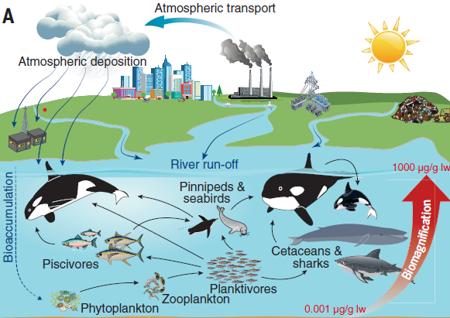
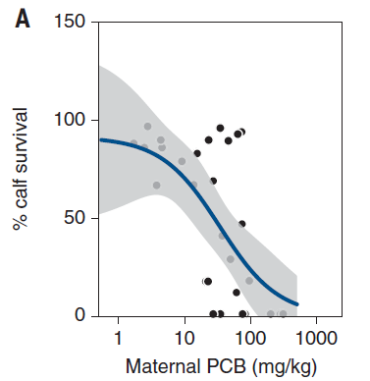
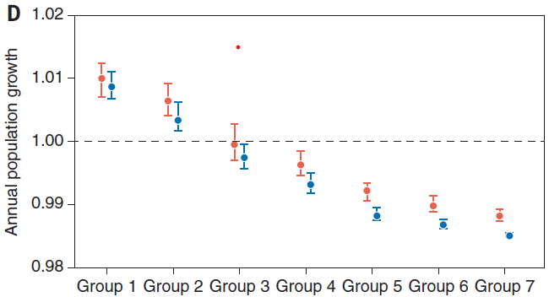
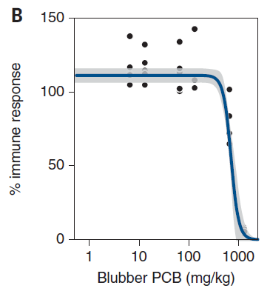
Effect of Polychlorinated Biphenyls (PCB) on the immune system and survival of killer whales
Jeet Mukhopadhyay
jeetvk0018@gmail.com
Department of Life Sciences, Presidency University, 86/1, College Street, Kolkata –700073, West Bengal, India.
gIntroduction
PCB was used as coolants in air conditoners and refrigerators.
It lead to enormous contamination of the biosphere.
This affected the killer whale population .
PCB contamination in killer whales posed a threat to their survival since it affected their immune system.
sMotivation
The experimental process is non invasive.
The whole process was environment friendly.
We can also predict how other toxic compounds can affect the immunity and survival of killer whales.
Methodology
Data on blubber PCB concentrations of killer whales was collected.
The data was compared to known PCB concentrations and response relationship graphs.
Potential annual population growth rate λ was calculated.
Results
.
Females show lower PCB accumulation than males due to maternal lactation.
Food source is related to the amount of PCB in killer whale since biomagnification occurs through trophic levels.
Killer whales are presently found mostly in arctic and Antarctic regions.
Conclusion
High risk of killer whale population collapsing in the next 100 years.
Concerted efforts are needed to destroy remaining PCB sources.
Reference
Desforges, J. P., Hall, A., McConnell, B., Rosing-Asvid, A., Barber, J. L., Brownlow, A., ... & Dietz, R. (2018). Predicting global killer whale population collapse from PCB pollution. Science, 361(6409), 1373-1376.
PCB accumulation and biomagnification.
Relation between calf survival and maternal adipose PCB concentration.
Annual population growth rate
Immune suppression as function of blubber PCB concrentration,

